Slide 1

Chapter 8
How to code control statement
Notes:
Session: Ghi số thứ tự session trong môn học
Session Name: ghi tên của session sẽ dạy

Slide 2
Objectives
How to code conditional expressions
How to code selection structures
The Invoice application
How to code the iteration structures
Notes:
Mô tả nội dung mà học viên phải đạt được khi kết thúc môn học này

Slide 3
How to code conditional expressions
Notes:
Session: Ghi số thứ tự session trong môn học
Session Name: ghi tên của session sẽ dạy

Slide 4
How to use the equality and identity operators
The equality operators
The identity operators
Operator | Description | Example
== | Equal | lastName == “Hopper”
!= | Not equal | Months !=0
Operator | Description | Example
=== | Equal | lastName === “Hopper”
!== | Not equal | Months !==0

Slide 5
How to use the equality and identity operators (cont.)
The equality operators perform type coercion whenever that’s necessary. That means they convert data from one type to another before perform operator.
The identity operators do not perform type coercion. If the two operands are different types, the result will always be false.

Slide 6
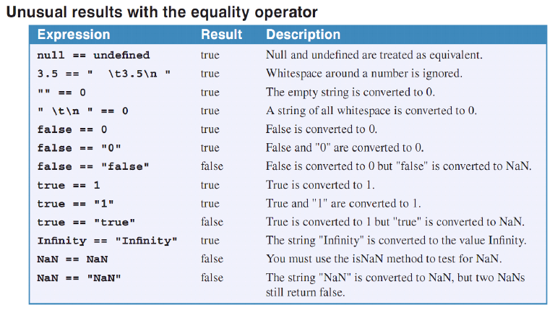

Slide 7
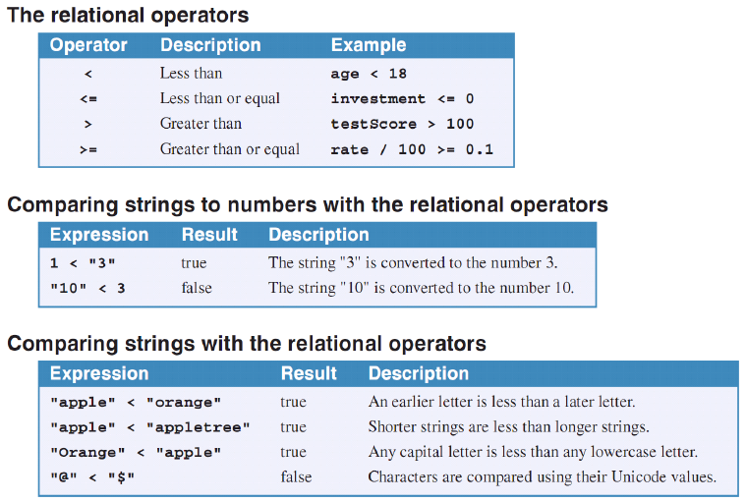
How to use the relational operators

Slide 8
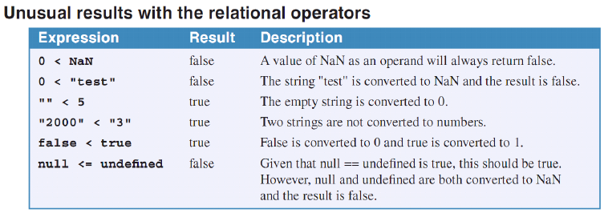
How to use the relational operators (cont.)

Slide 9
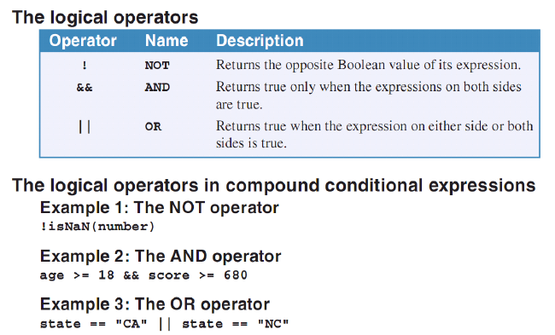
How to use the logical operators

Slide 10
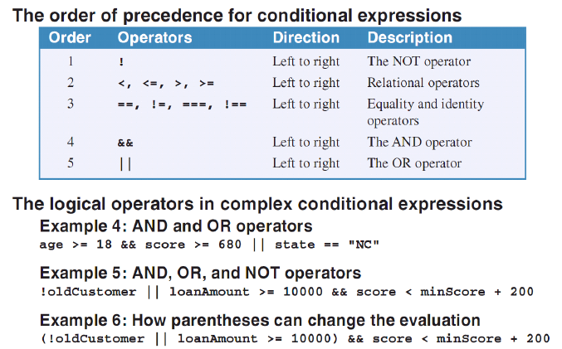
How to use the logical operators (cont.)

Slide 11
How to code the selection structures
Notes:
Session: Ghi số thứ tự session trong môn học
Session Name: ghi tên của session sẽ dạy

Slide 12
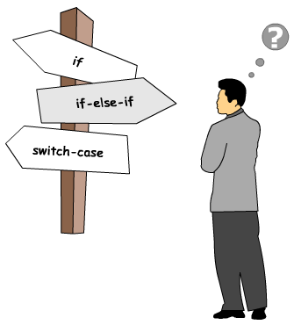

How to code if statements
Decision-making statements enable us to change the flow of the program
Decision-making statements supported by JavaScript:

Slide 13
if Statement
Syntax:
if (booleanExpression)
{statements}
[else if (booleanExpression)
{statements}]
[else {statements}]

Slide 14
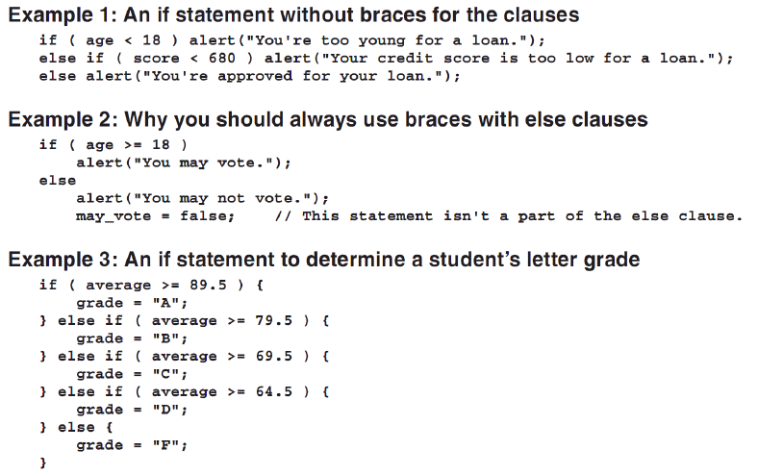
If statements - Example

Slide 15
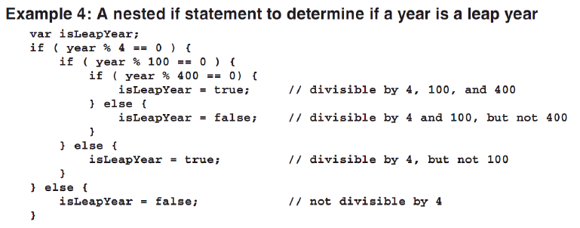
If statements – Example -2

Slide 16
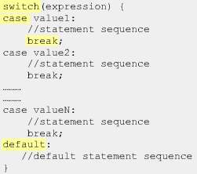
How to code switch statements
Switch statement is a form or if statements. It is use to replace for if statement in multiple if..else.

Slide 17
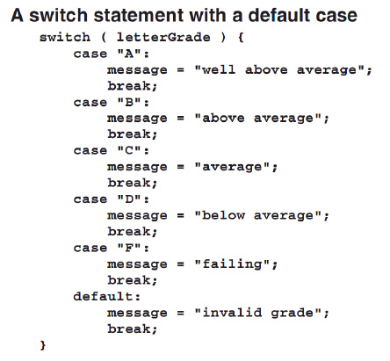
switch statements - example

Slide 18
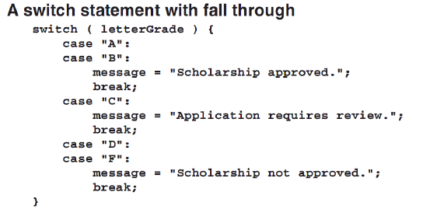
switch statements - example-2

Slide 19
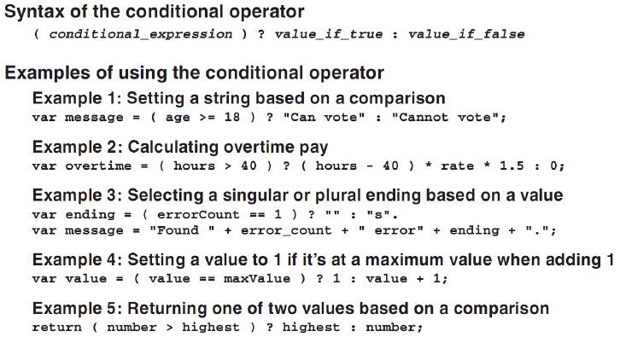
How to use the condition operator

Slide 20
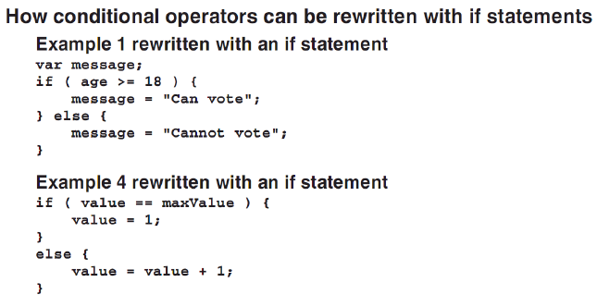
How to use the condition operators -2

Slide 21
How to use the AND and OR operators for selections
Example 1: An OR selection that returns a Boolean value
var selected =(state===“CA” || state===“NC”);
Example 2: An AND selection that returns a null, undefined, or String value
var selected = state && state.toString();
Example 3: An OR selection that won’t return null or undefined value
var selected = state ||”CA”;
Example 4: An OR selection that set default value
var selected = dt || new Date();

Slide 22
How to use the AND and OR operators for selections (cont.)
These
var selected =(state===“CA” || state===“NC”);
Example 2: An AND selection that returns a null, undefined, or String value
var selected = state && state.toString();
Example 3: An OR selection that won’t return null or undefined value
var selected = state ||”CA”;
Example 4: An OR selection that set default value
var selected = dt || new Date();

Slide 23
How to use the AND and OR operators for selections (cont.)
How to rewrite selections
Example 1:
var selected =false;
if(state===“CA” || state===“NC”){
selected =true;
}
Example 2:
var selected;
if(state){
selected =sate.toString();
}

Slide 24
How to use the AND and OR operators for selections (cont.)
How to rewrite selections
Example 3:
var selected =“CA”;
if(state){
selected =state;
}
Example 4:
var selected =dt;
if(!selected){
selected = new Date();
}

Slide 25
The Invoice Application
Notes:
Session: Ghi số thứ tự session trong môn học
Session Name: ghi tên của session sẽ dạy

Slide 26
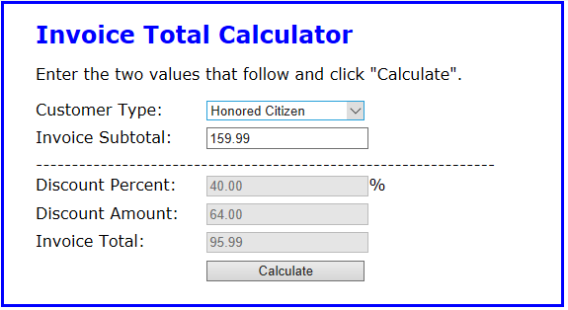
The Invoice Application
The User Interface

Slide 27
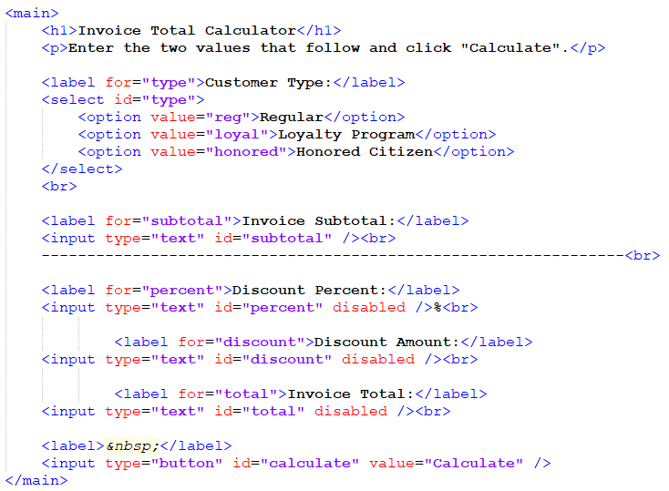
The Invoice Application (cont.)
The HTML code

Slide 28
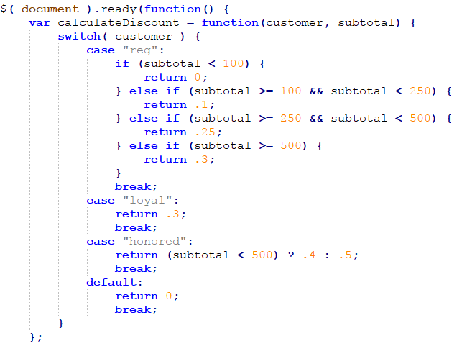
The Invoice Application (cont.)
The JavaScript code

Slide 29
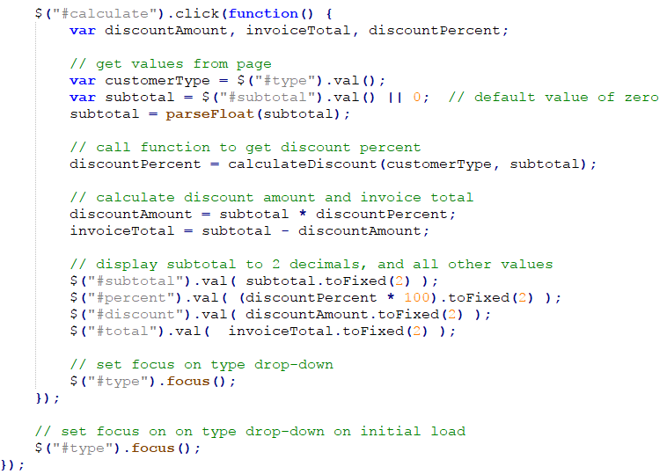
The Invoice Application (cont.)
The JavaScript code

Slide 30
How to code the iteration structures
Notes:
Session: Ghi số thứ tự session trong môn học
Session Name: ghi tên của session sẽ dạy

Slide 31
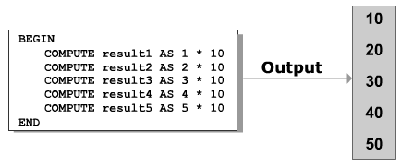
Loops

Slide 32
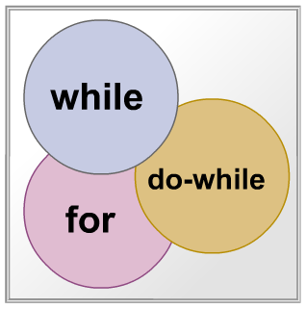
Types of Loops
A loop comprises a statement or block of statement s that are execute repeatedly until a particular condition evaluate to true or false

Slide 33

Syntax of while loop
while statement in Java is used to execute a statement or block of statement while a particular condition is true
expression: is a condition which return boolean value

Slide 34
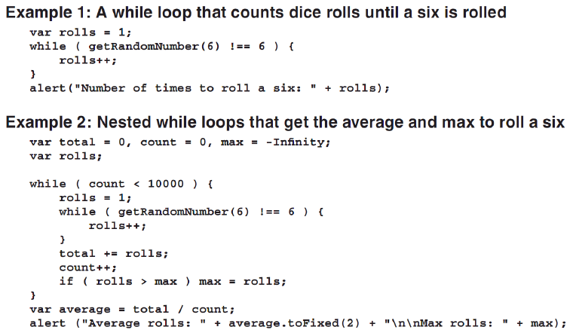
Examples

Slide 35

Syntax of Do-While Statement
The do-while statement check the condition at the end of the loop rather than at the beginning to assure that the loop is executed at least once
expression: is a condition which return boolean value

Slide 36
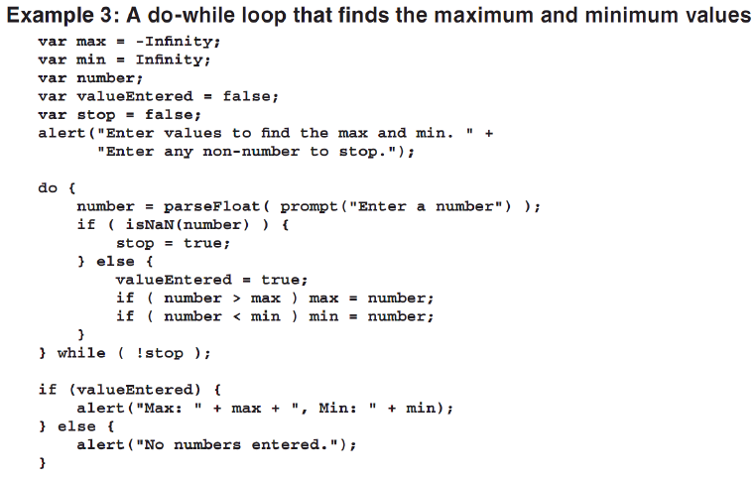
Examples
Notes:
Giáo viên có thể lấy ví dụ dễ hơn để dạy. Ví dụ: Cộng 10 số nguyên từ 1..10 cho dễ hiểu.

Slide 37

Syntax of For Statement
The for is similar to the while statement in its function

Slide 38
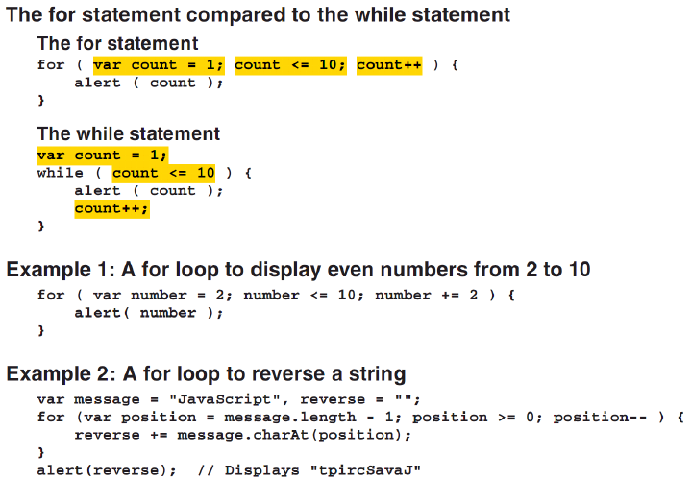
Examples

Slide 39
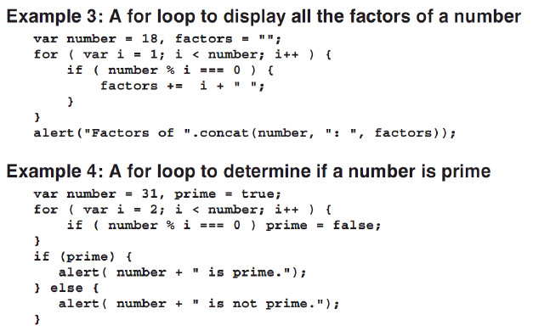
Examples -2

Slide 40
Break statement
The break statement in Java is used in two ways
It can be used to terminate a case in switch statement
It forces immediate termination of a loop

Slide 41
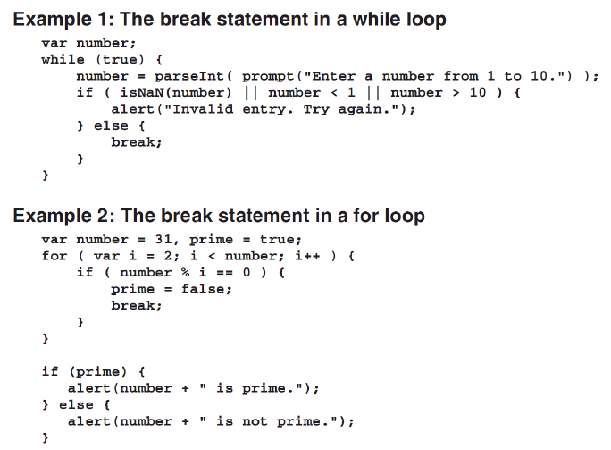
Example

Slide 42
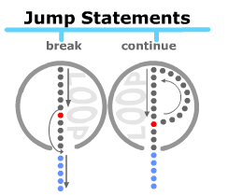
Continue statement
To skip the statements within a loop and proceed to the next iteration of the loop

Slide 43
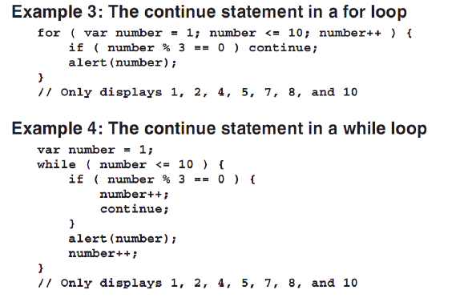
Example for continue statement

Slide 44
Summary
The equality operators perform type coercion whenever that’s necessary. The identity operators do not perform type coercion. If the two operands are different types, the result will always be false.
Decision-making statements enable us to change the flow of the program. Decision-making statements supported by JavaScript: if, is..else, switch..case
Condition operation is a shorthand for if statement.
A loop comprises a statement or block of statement s that are execute repeatedly until a particular condition evaluate to true or false.
JavaScript use 03 types of loop are while, do..while and for statements.
Notes:
Tóm tắt lại nội dung đã học

Slide 45
The End.

